Slide 1
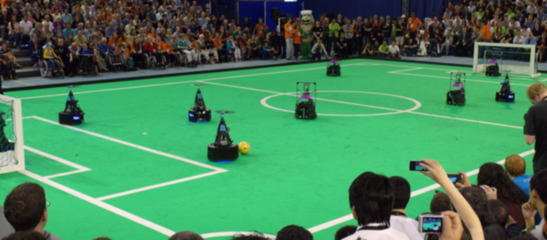
Stakeholder meeting- AutoRef
15/03/2024
Quinten Swaan-Project Manager
Department of Mathematics and Computer Science, EngD. Mechatronic Systems Design

Slide 2
Agenda
Goal: Update on Progress.
Planning
Updated Requirement
Updated Risks
Updated system context
Possible Solutions for Last touch
Ball out of play
UI communication
Integration
Summary
14:00 – 14:05
14:05 – 14:10
14:10 – 14:15
14:15 – 14:20
14:20 – 14:35
14:35 – 14:42
14:42 – 14:50
14:50 – 14:58
14:58 – 15:00

Slide 3
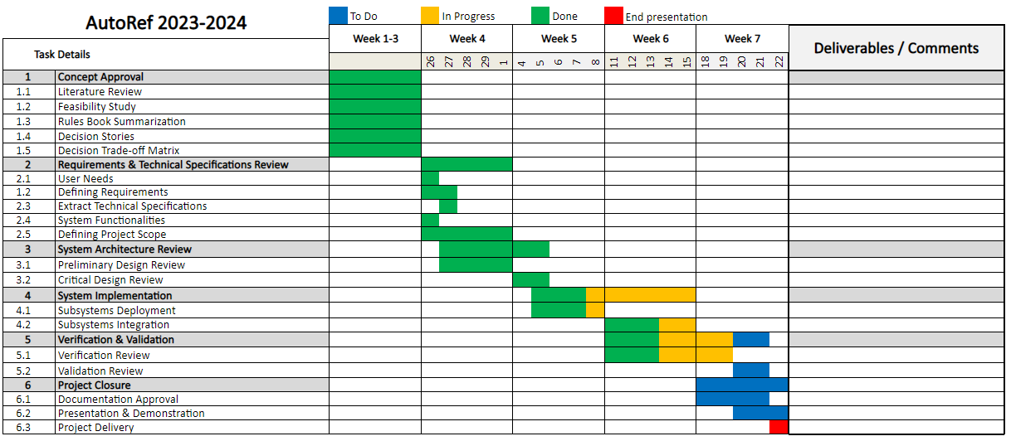
Planning

Slide 4
Updated Requirement
Acceptable Error in Distance
AR must have at max distance error between ball and line of ±1.5 cm.
Reason: Since the RoboCup rule is based on FIFA, the acceptance accuracy from FIFA using Goal-Line Technology was ±1.5 cm.

Slide 5
Updated Risks
Legend
Low
Edge cases
Medium
Occurrence
Integration
Sensing accuracy
High
Validation and verification
Trust
Bias
Severity

Slide 6
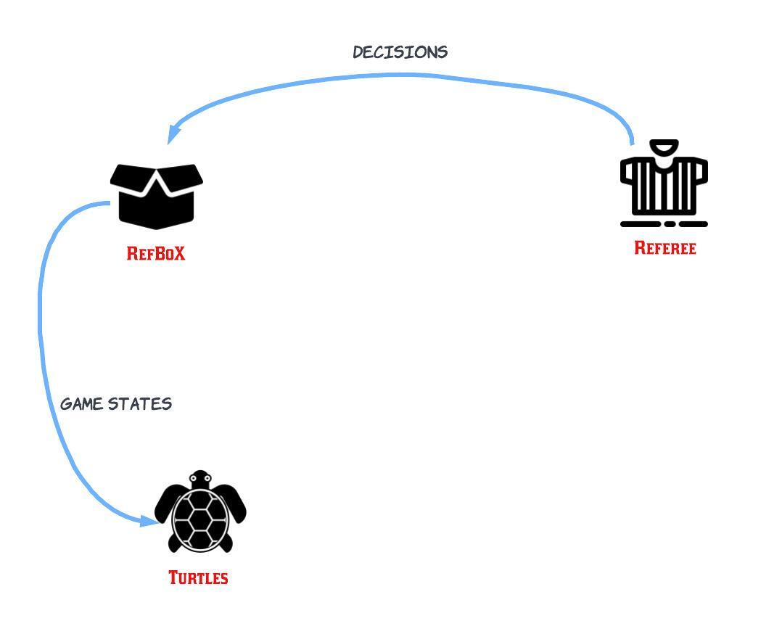
Updated System Context- Communication
Tech United Communication
Notes:
Deniz?

Slide 7
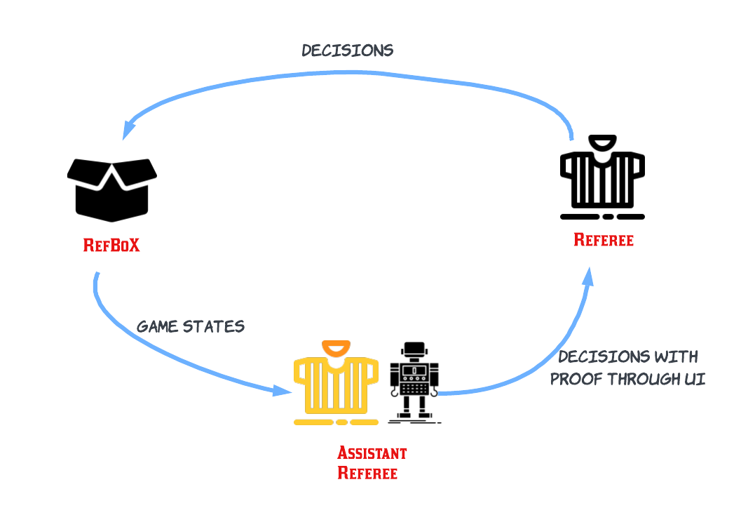
Updated System Context- Communication
Ideal Assistant Referee Communication
Notes:
Deniz?

Slide 8
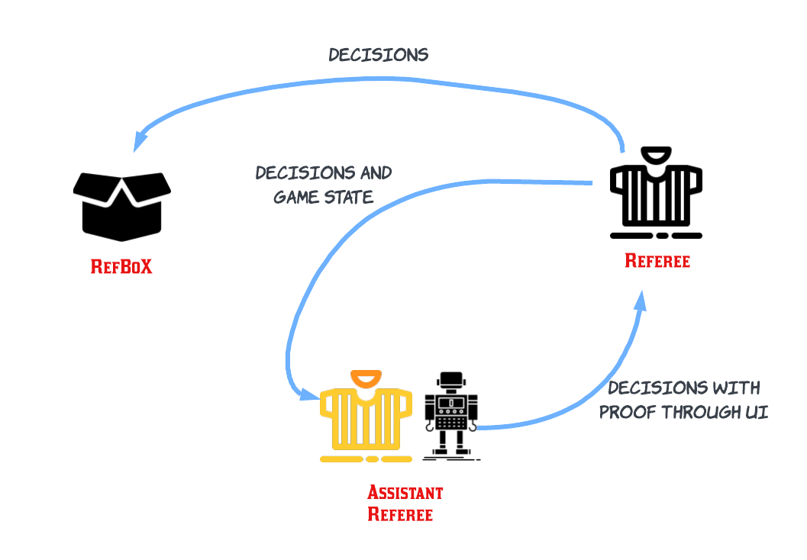
Updated System Context- Communication
Proposed Assistant Referee Communication
Notes:
Deniz?

Slide 9
Possible Solutions for Last Touch Detection
Boundary Frames
Frames over objects (ball and players)
Trajectory Tracking
Physics Based Model
Kalman Filtering
Trajectory prediction using regression
Trajectory Extrapolation
Classification
Binary Classifier
Notes:
Deniz?

Slide 10
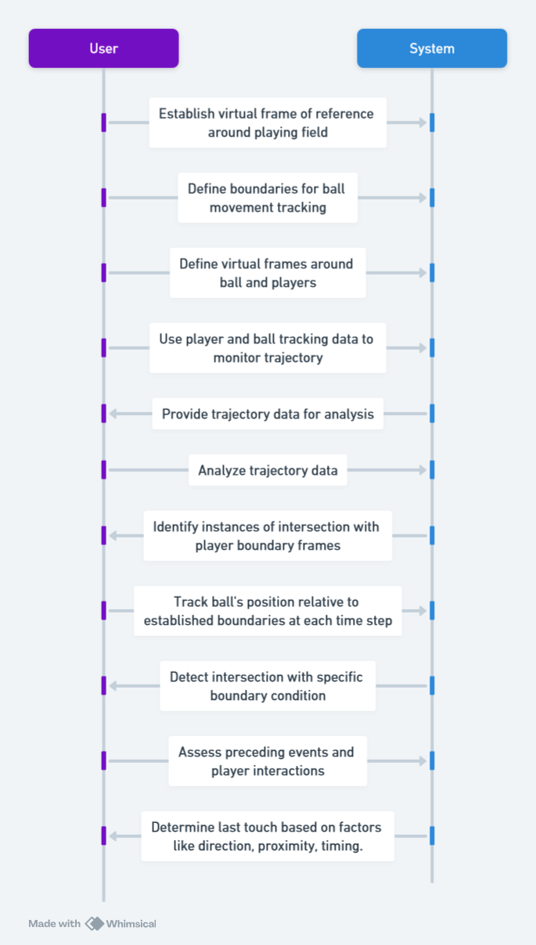
Possible Solutions for Last Touch Detection
Boundary Frames​
Notes:
Deniz?

Slide 11
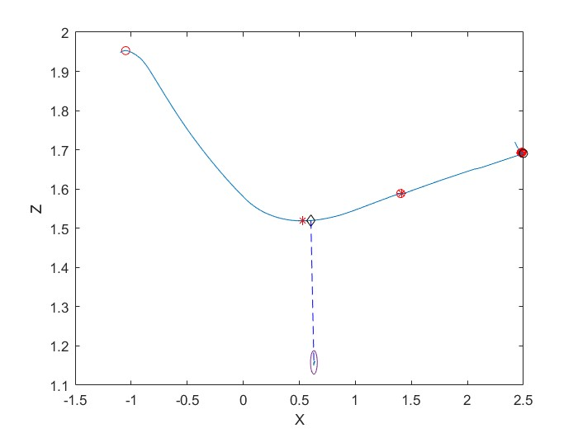
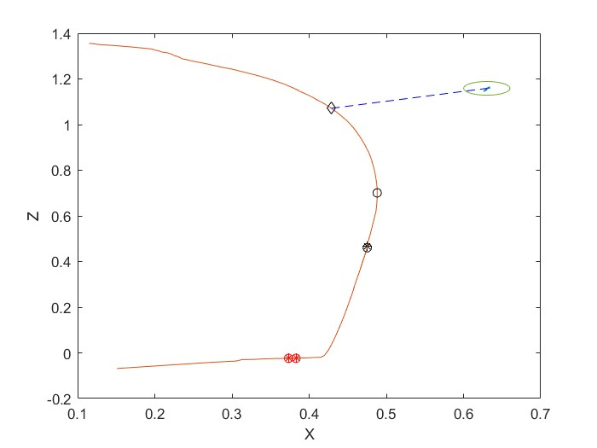
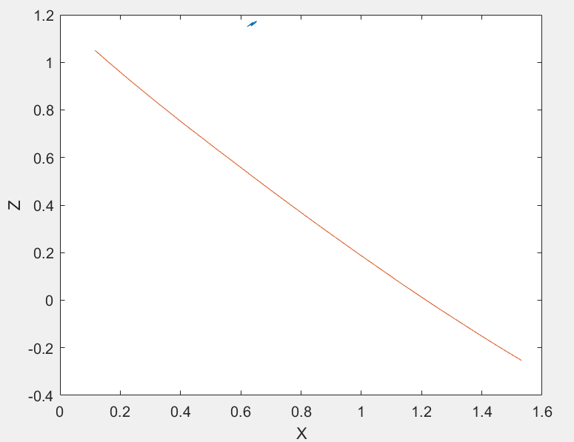
Possible Solutions for Last Touch Detection
No Touch
Touch
Touch
Notes:
Deniz?

Slide 12
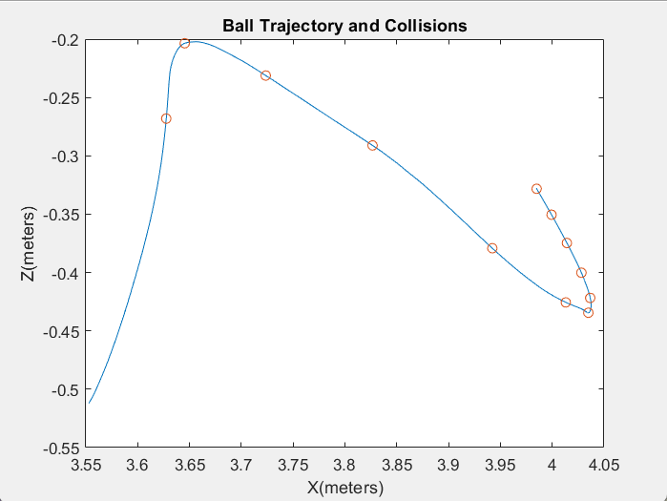
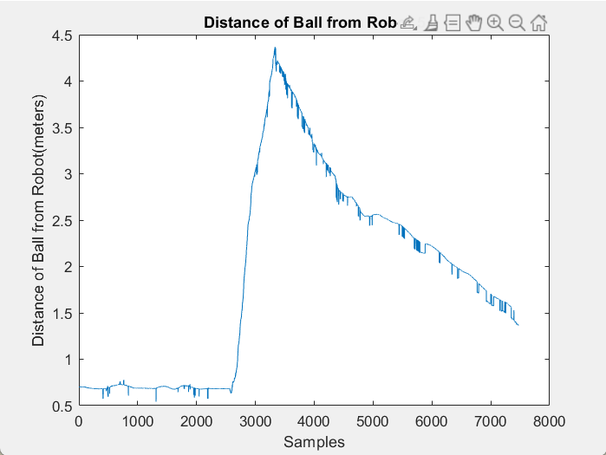
Last Touch- Regression for Collision Detection and Clamping
Notes:
Deniz?

Slide 13
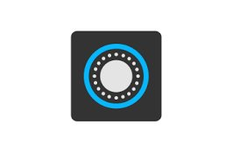
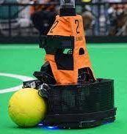
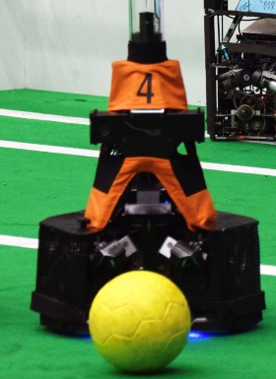
Binary Classifier
Dataset
Feature Extraction
Ball Pose
Robot Pose
Other Features
Label
The dataset contains 987 rows and 5 columns.
Other Features:
X_dist
Y_dist
Z_dist
Distance
Touch
No Touch
Notes:
Deniz?

Slide 14
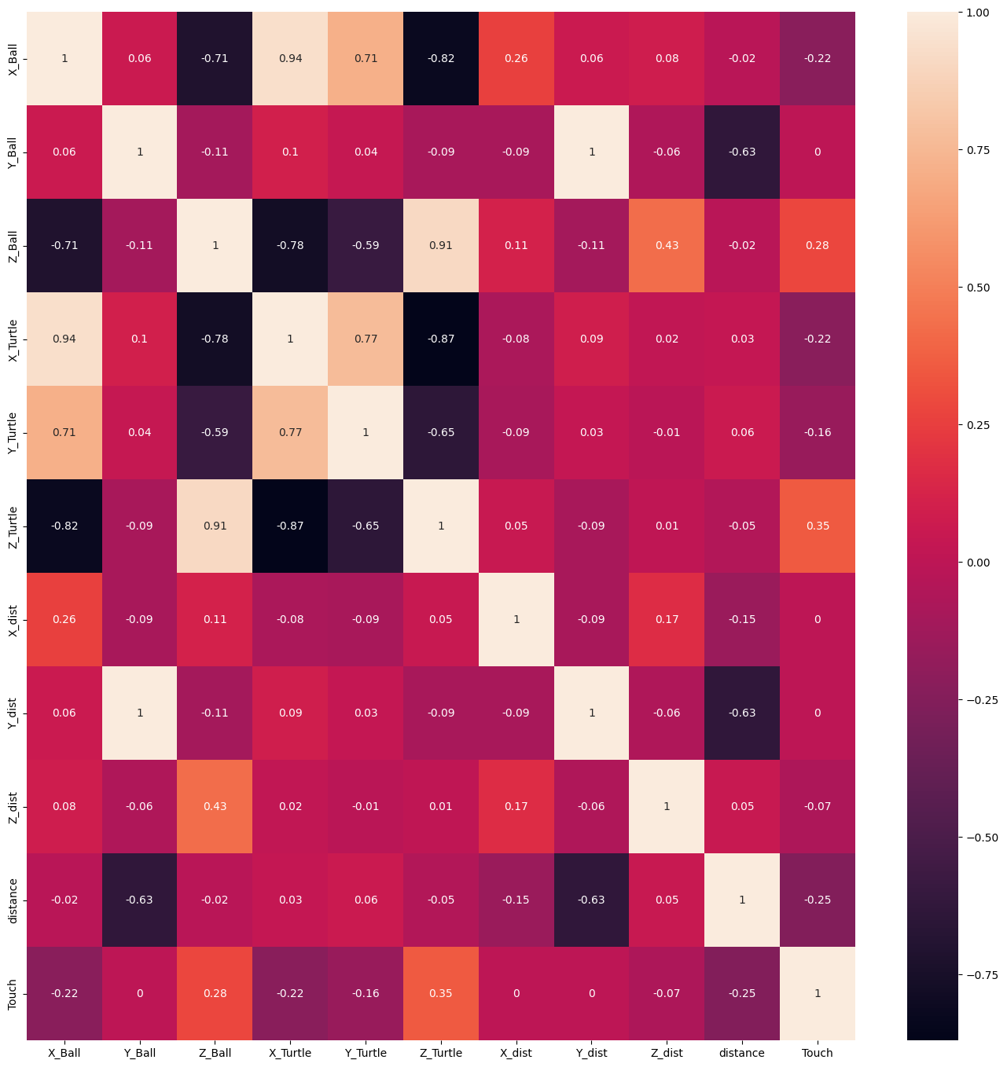
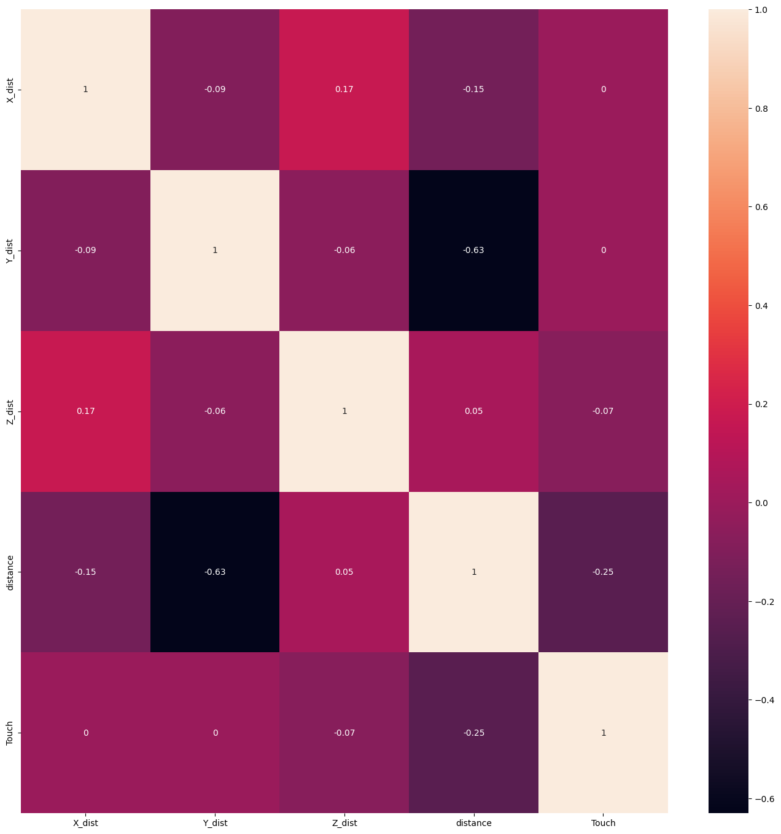
Binary Classifier
Notes:
Deniz?

Slide 15
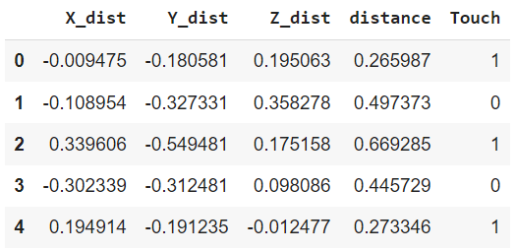
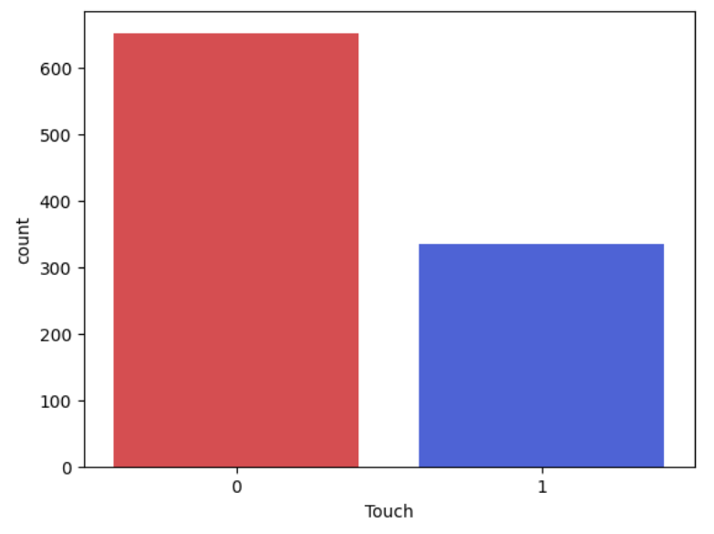
Binary Classifier
Dataset
652
335
Notes:
Deniz?

Slide 16
Binary Classifier
Split Dataset
Training Set
Validation Set
Test Set
Train a Binary Classifier
Validate Model's performance
Check the model's Generalization
Number of samples in each set:
Training Set: 64%
Validation Set: 16%
Test Set: 20%
Notes:
Deniz?

Slide 17
Binary Classifier
Model Selection
Set | Acc | Classes | Precision | Recall | F1-Score
Support Vector Machine
Validation Set | 84% | No Touch | 0.88 | 0.87 | 0.87
 |  | Touch | 0.79 | 0.80 | 0.79
Test Set | 88% | No Touch | 0.92 | 0.91 | 0.91
 |  | Touch | 0.79 | 0.82 | 0.81
Set | Acc | Classes | Precision | Recall | F1-Score
Decision Tree
Validation Set | 89% | No Touch | 0.89 | 0.93 | 0.91
 |  | Touch | 0.88 | 0.82 | 0.84
Test Set | 82% | No Touch | 0.91 | 0.82 | 0.87
 |  | Touch | 0.68 | 0.82 | 0.74
Multi-Layer Perceptron
Validation Set | 87% | No Touch | 0.90 | 0.9 | 0.9
 |  | Touch | 0.83 | 0.83 | 0.83
Test Set | 87% | No Touch | 0.92 | 0.89 | 0.91
 |  | Touch | 0.77 | 0.84 | 0.80
Random Forest
Validation Set | 89% | No Touch | 0.91 | 0.92 | 0.91
 |  | Touch | 0.86 | 0.85 | 0.86
Test Set | 89% | No Touch | 0.95 | 0.89 | 0.92
 |  | Touch | 0.79 | 0.90 | 0.84
Notes:
Deniz?

Slide 18
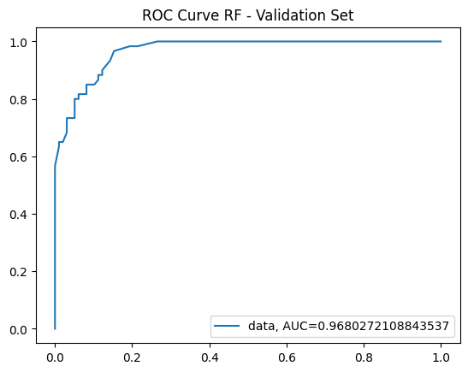
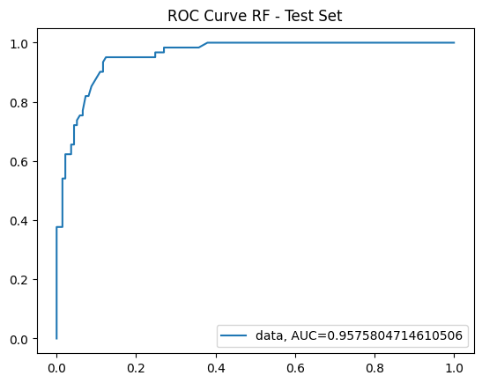
Binary Classifier
ROC and AUC for the Best Model
True Positive Rate
True Positive Rate
False Positive Rate
False Positive Rate
Notes:
Deniz?

Slide 19
Binary Classifier
Real-Time - Evaluation
Confusion Matrix
 |  | Actual Values
 |  | Touch | No Touch
Predicted Values | Touch | 14 | 3
 | No Touch | 1 | 12
Evaluation Metrics
Classes | Precision | Recall | F1-Score
No Touch | 0.92 | 0.80 | 0.85
Touch | 0.82 | 0.93 | 0.87
Accuracy | 86%
Notes:
Deniz?

Slide 20
Binary Classifier
Improving RF Classifier’s Performance
Set | Acc | Classes | Precision | Recall | F1-Score
n_estimators = 25
Validation Set | 89% | No Touch | 0.91 | 0.92 | 0.91
 |  | Touch | 0.86 | 0.85 | 0.86
Test Set | 89% | No Touch | 0.95 | 0.89 | 0.92
 |  | Touch | 0.79 | 0.90 | 0.84
n_estimators = 80
Validation Set | 92% | No Touch | 0.93 | 0.94 | 0.93
 |  | Touch | 0.90 | 0.88 | 0.89
Test Set | 90% | No Touch | 0.95 | 0.91 | 0.93
 |  | Touch | 0.81 | 0.89 | 0.84
Notes:
Deniz?

Slide 21
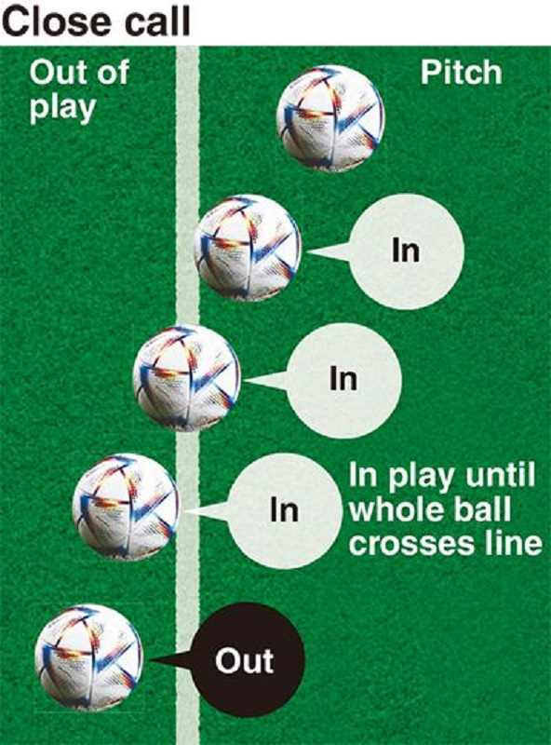
Ball out of play
Requirement
AR must have a maximal distance error between the ball and line of ±1.5 cm.
OptiTrack
Ball centre point
AR
Rules
Ball radius
Ball in/out play
Calibration
Line coordinates

Slide 22
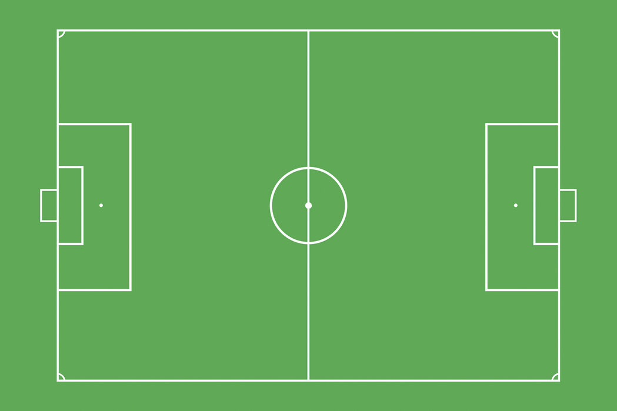
Ball out of play - verification
Verification
Ground truth location of ball vs system location of ball.
Only compare one coordinate.
32 samples with different velocities between 1.5 m/s and 7 m/s.
x
z

Slide 23
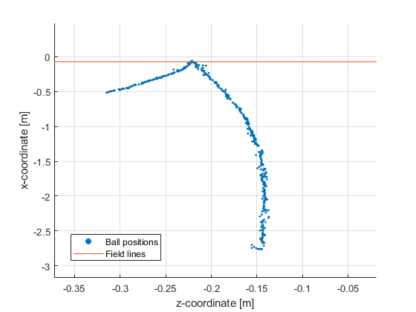
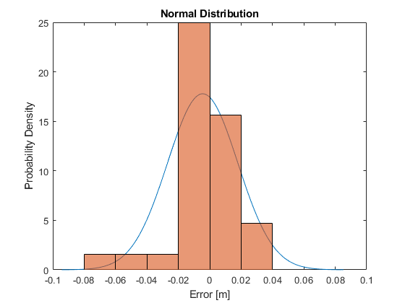
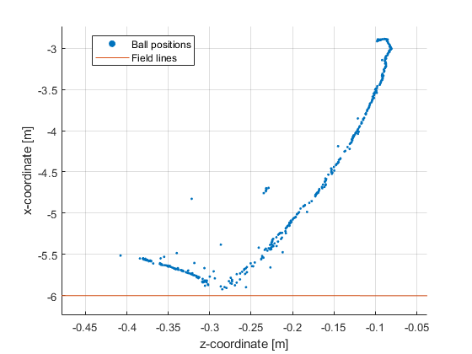
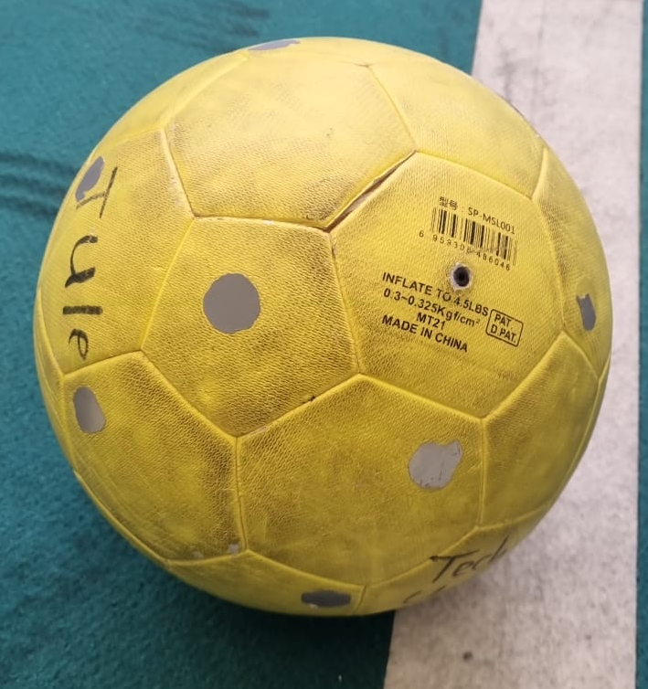
Ball out of play - Verification
Results
Assume normal distribution and sufficient samples with central limit theorem.
Error is within -0.45 ± 4.49 cm with 95% confidence interval.
Requirement not met!
Add extra markers to ball.

Slide 24
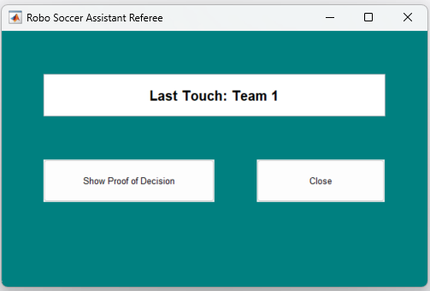
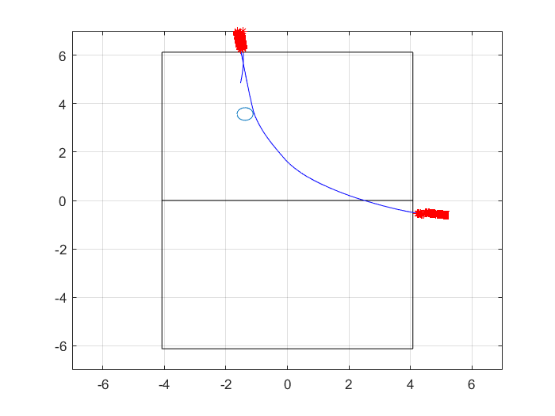
UI for Communicating Last Touch
“Show proof of decision” will show the proof and closes the window
“Close” will close the window

Slide 25
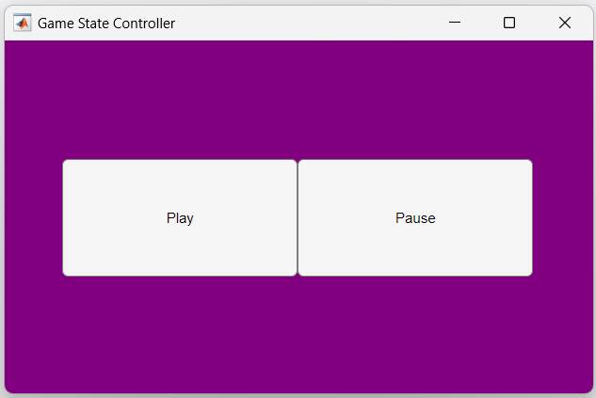
UI for GameState
Input to the system
Play and Pause

Slide 26


Integration
Main Algorithm
Referee
Input
Optitrack
Decision Algorithm
Touch Detection
User Interface
Decision
Proof
BOOP
Stand-alone
Fully integrated

Slide 27
Summary

